Slide 1

Jinit Dipesh Desai Alsten Vaz (Project Manager) Shiva Sourav Kasula Anil Kumble Bethapudi (Project Owner)
Amir Zakik Pankti Alpesh Desai (Business Analyst) Huzefa Sadikot Jayesh Lad (Lead Developer) Niyati Trivedi Anudeep Reddy Suram (Developer)
Yakshita Rakholiya Venkata Sai Kunduru (Lead DBA) Fnu Pariva Chinmay Deshpande (QA Analyst)
Bansariben Sorathiya Vatsalkumar Balar (Software Tester)

Slide 2
Table of Contents
BRM Diagram, SIPOC, User Roles
Context Diagram, System Interface Table
User Stories with columns “Constraints”, “Exceptions”
RoadMap (S1,S2,S3)
RTM, RCT –Planning (S1,S2,S3)
UML Activity Diagram
Burndown Charts (S1,S2,S3)
ER Diagrams (conceptual, logical)
Jenkins Progress Report (S1,S2,S3)
Application Demo Recorded

Slide 3
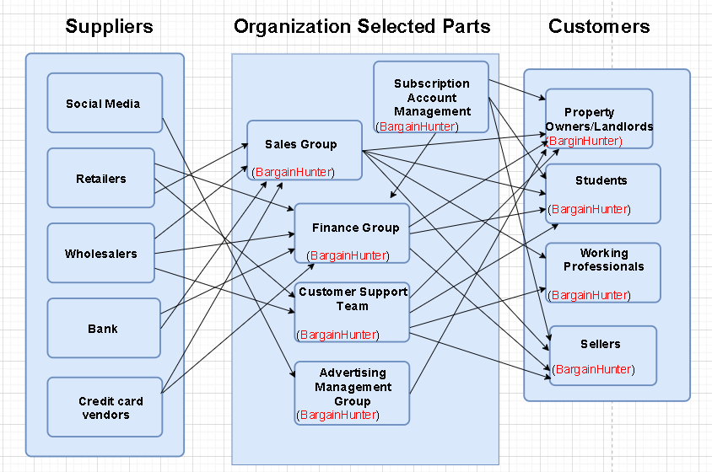
BRM Diagram (Presented By Jinit Dipesh Desai)
Suppliers
Organization selected parts
Customers

Slide 4
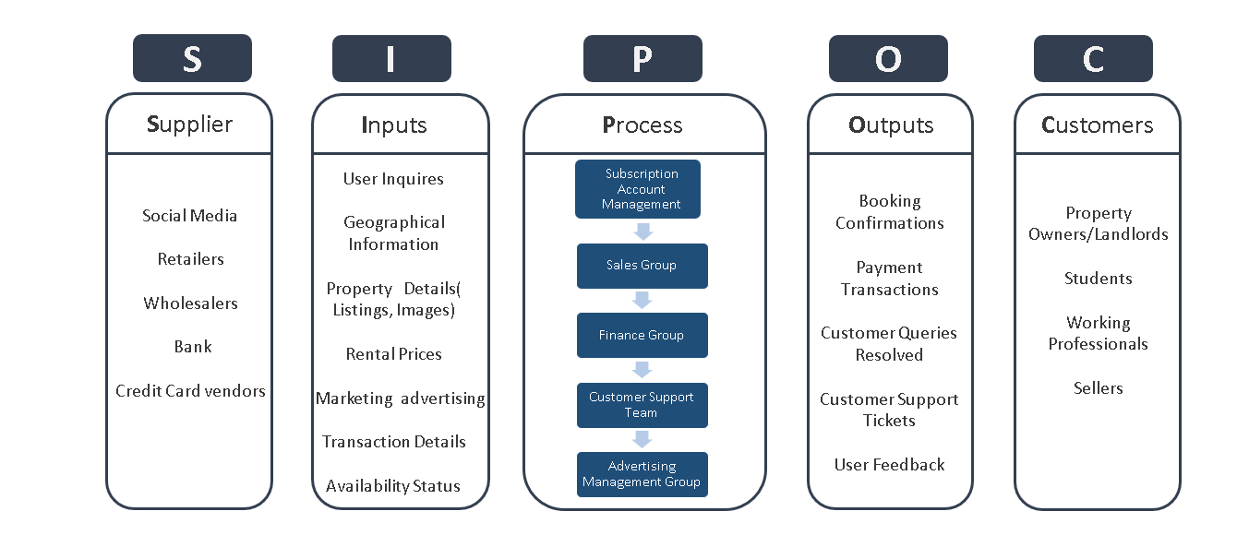
SIPOC (Presented by Fnu Pariva)
Suppliers
Organization selected parts
Customers

Slide 5
User Roles (Presented by Fnu Pariva)
Business Group | User Roles | Team Member Name (Bus. Group Proxy)
Subscription Account Management | Customer support | Shiva
Sales Group | Sales Manager | Yakshita
Finance Group | Budget Analyst Financial Analyst Accountant | Bansari
Customer Support Team | Social Media Support Specialist Live Chat support Agent | Pankti
Advertising Management Group | Marketing Strategist | Pariva

Slide 6
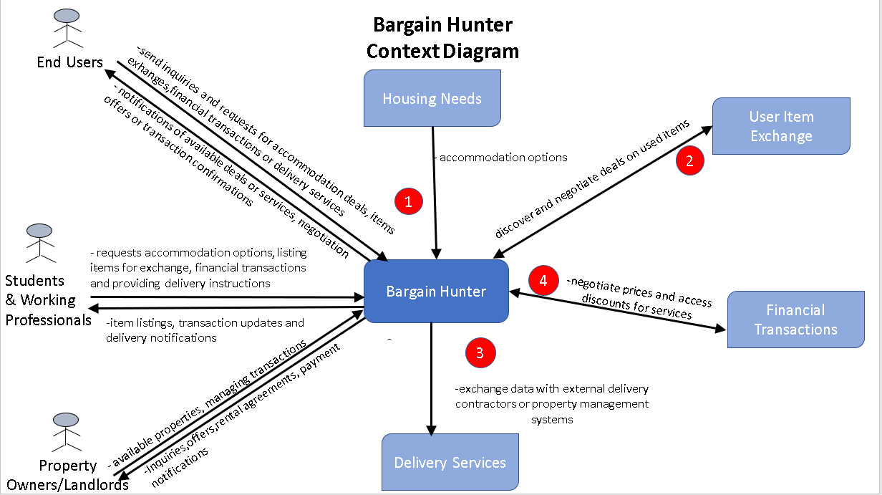
Context Diagram
(Presented by Anudeep Reddy Suram)

Slide 7
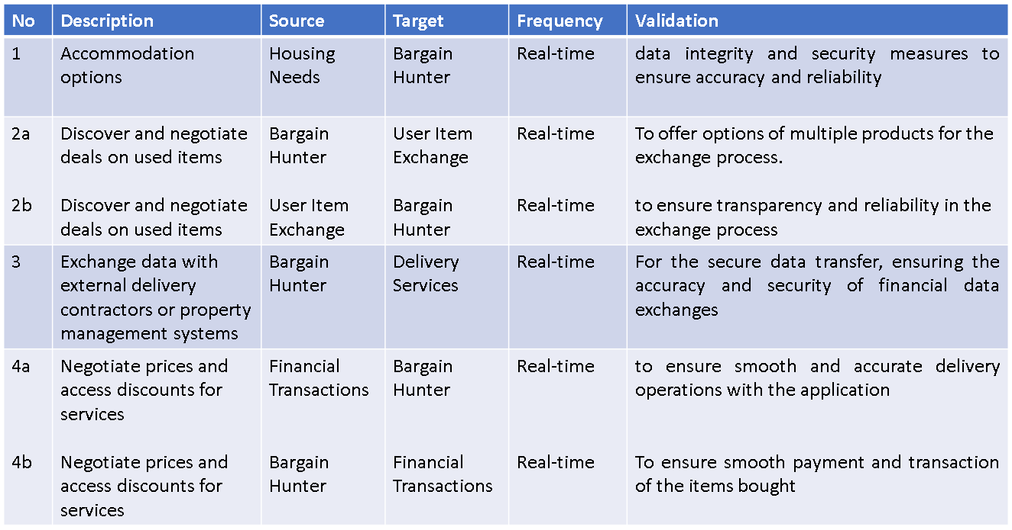
System Interface Table
(Presented by Bansariben Sorathiya)

Slide 8
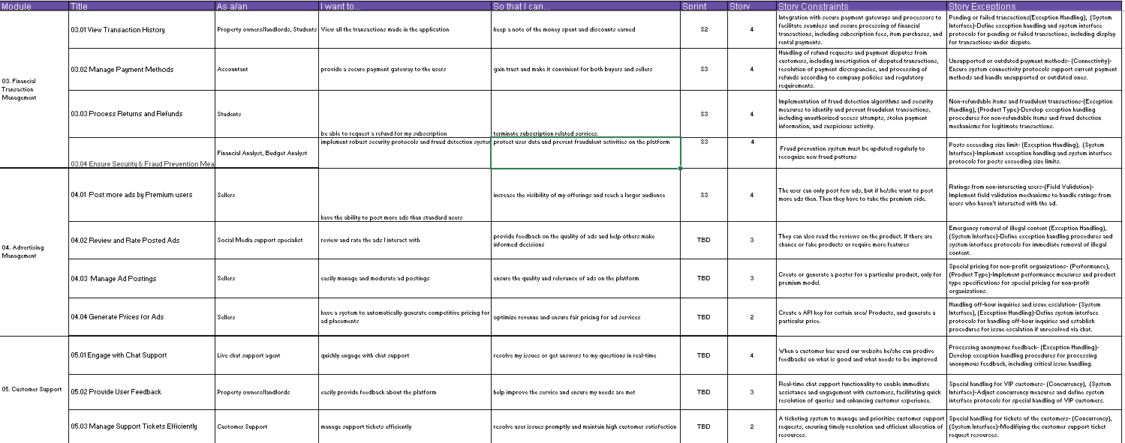
User Stories with columns “Constraints”, “Exceptions”
(Presented by Pankti Alpesh Desai)

Slide 9
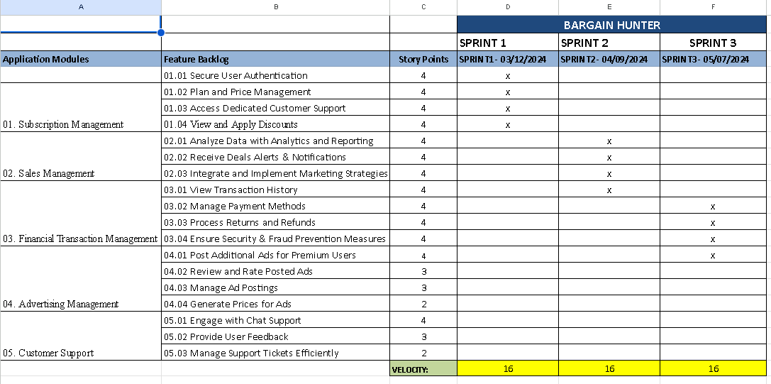
Road Map (S1, S2,S3)
(Presented by Amir Zakik)

Slide 10
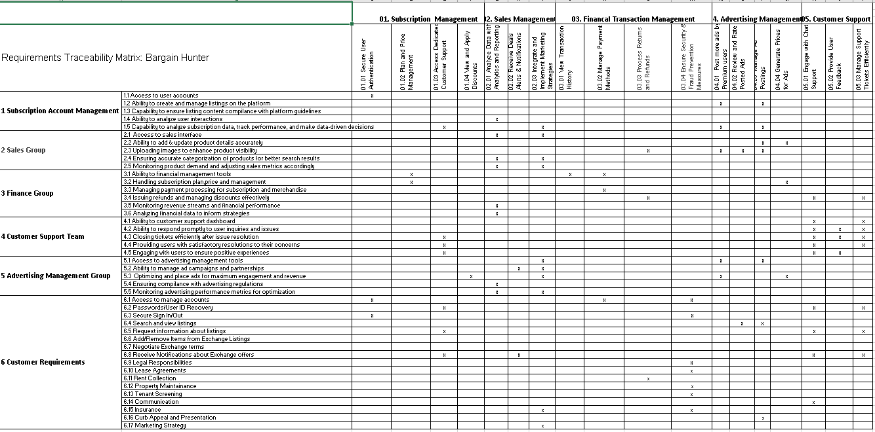
RTM- planning (S1,S2, S3)
(Presented by Huzefa Sadikot)

Slide 11
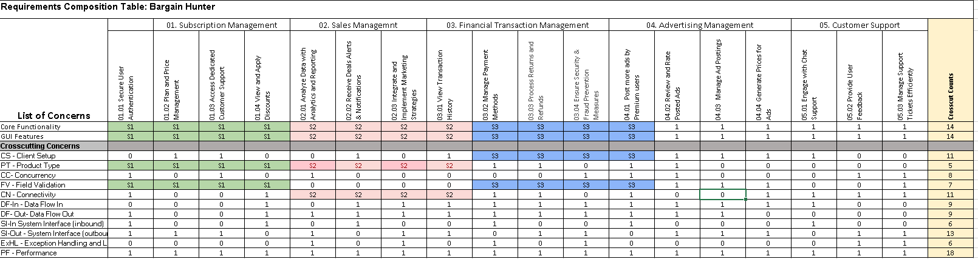
RCT –Planning (S1,S2,S3)
(Presented by Niyati Trivedi)

Slide 12
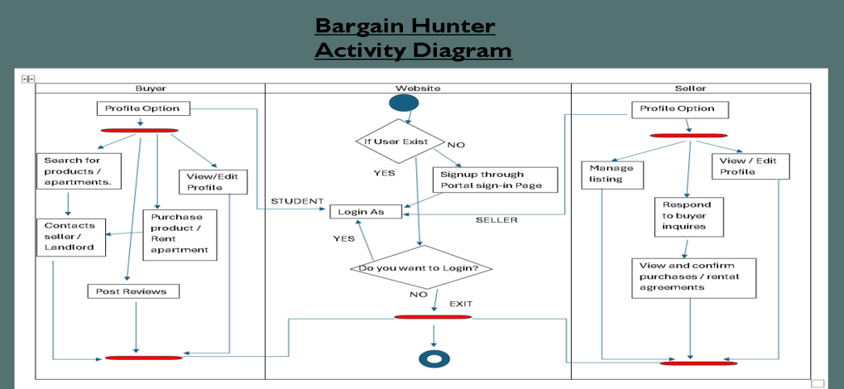
UML Activity Diagram
(Presented by Chinmay Deshpande)

Slide 13
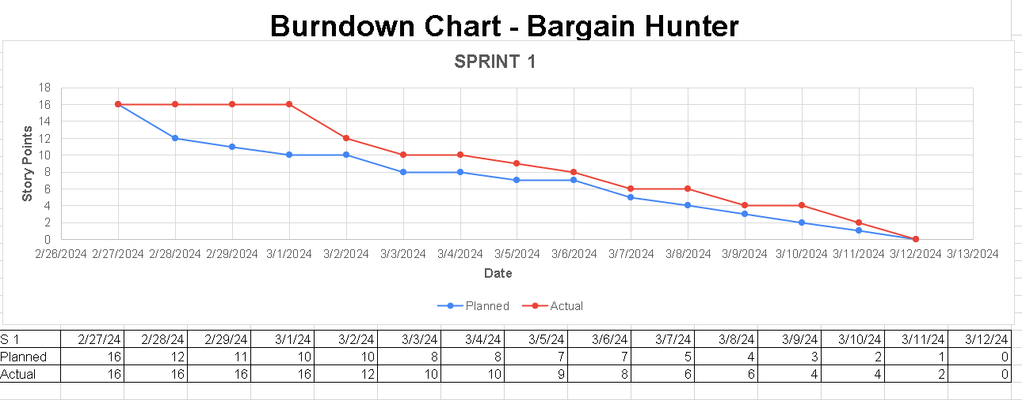
Burn Down Chart- Sprint 1
(Presented by Venkata Sai Kunduru )

Slide 14
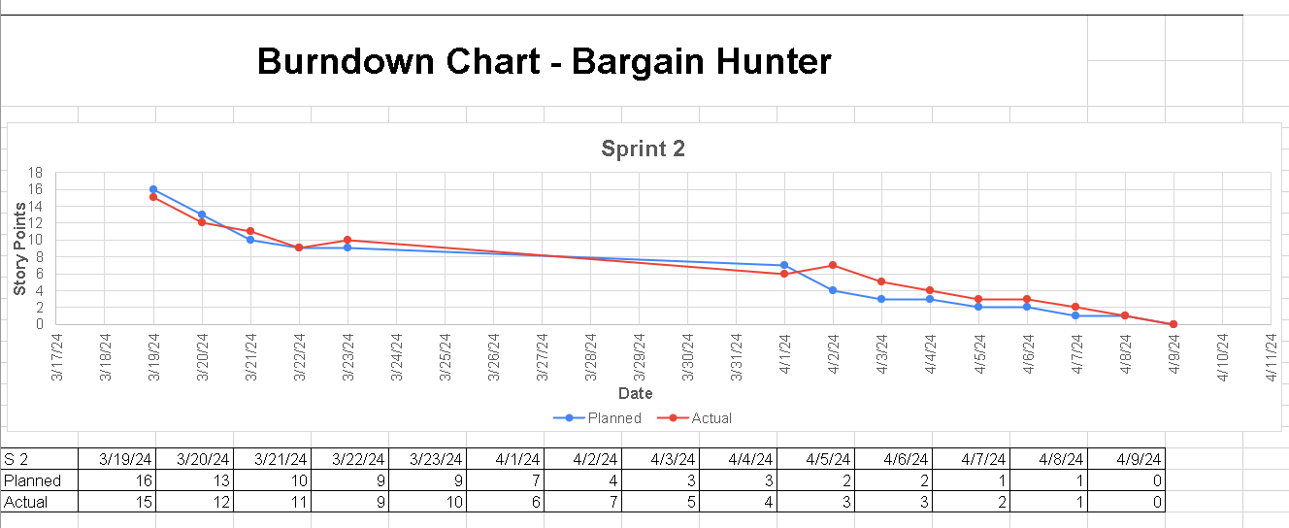
Burn Down Chart- Sprint 2
(Presented by Anil Kumble Bethapudi)

Slide 15
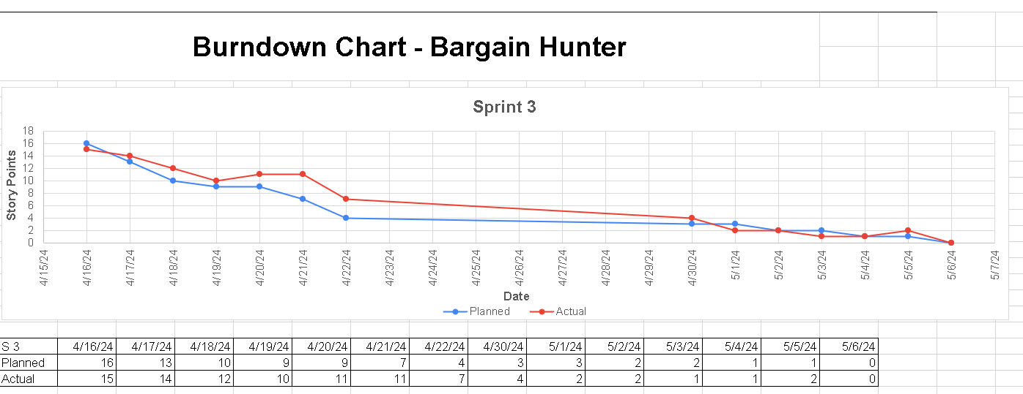
Burn Down Chart- Sprint 3
(Presented by Vatsalkumar Balar)

Slide 16
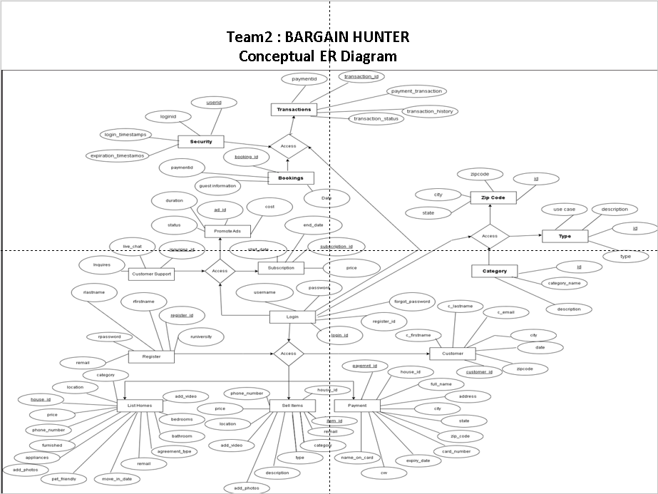
ER Diagrams- Conceptual (Presented by Shiva Sourav Kasula)

Slide 17
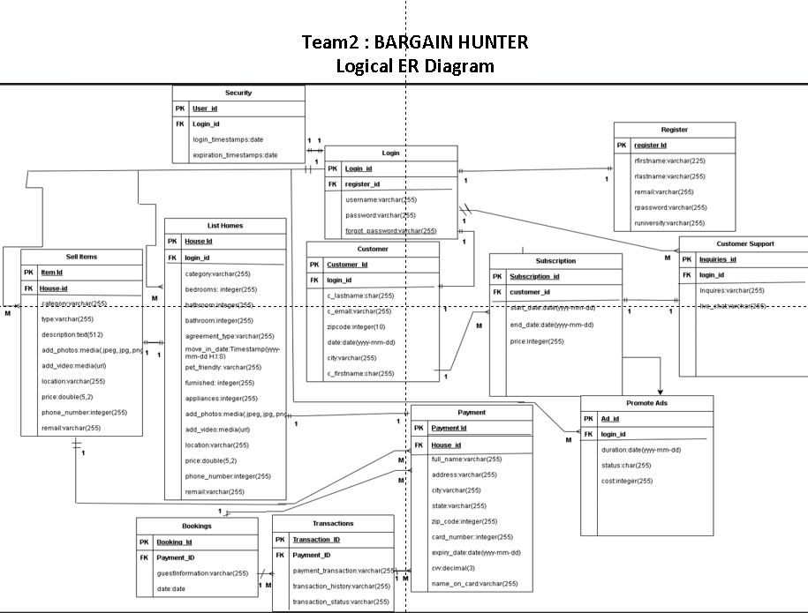
ER Diagrams- Logical (Presented by Jayesh Lad)

Slide 18
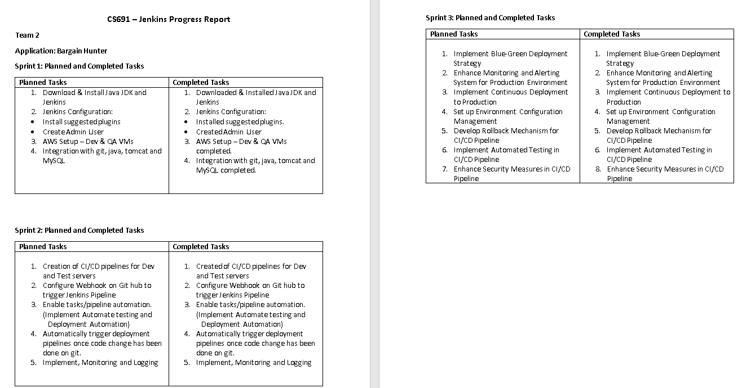
Jenkins Progress Report
(Presented by Alsten Vaz )

Slide 19
Thank You
From:-
Team 2(Bargain Hunter)

